Slide 1
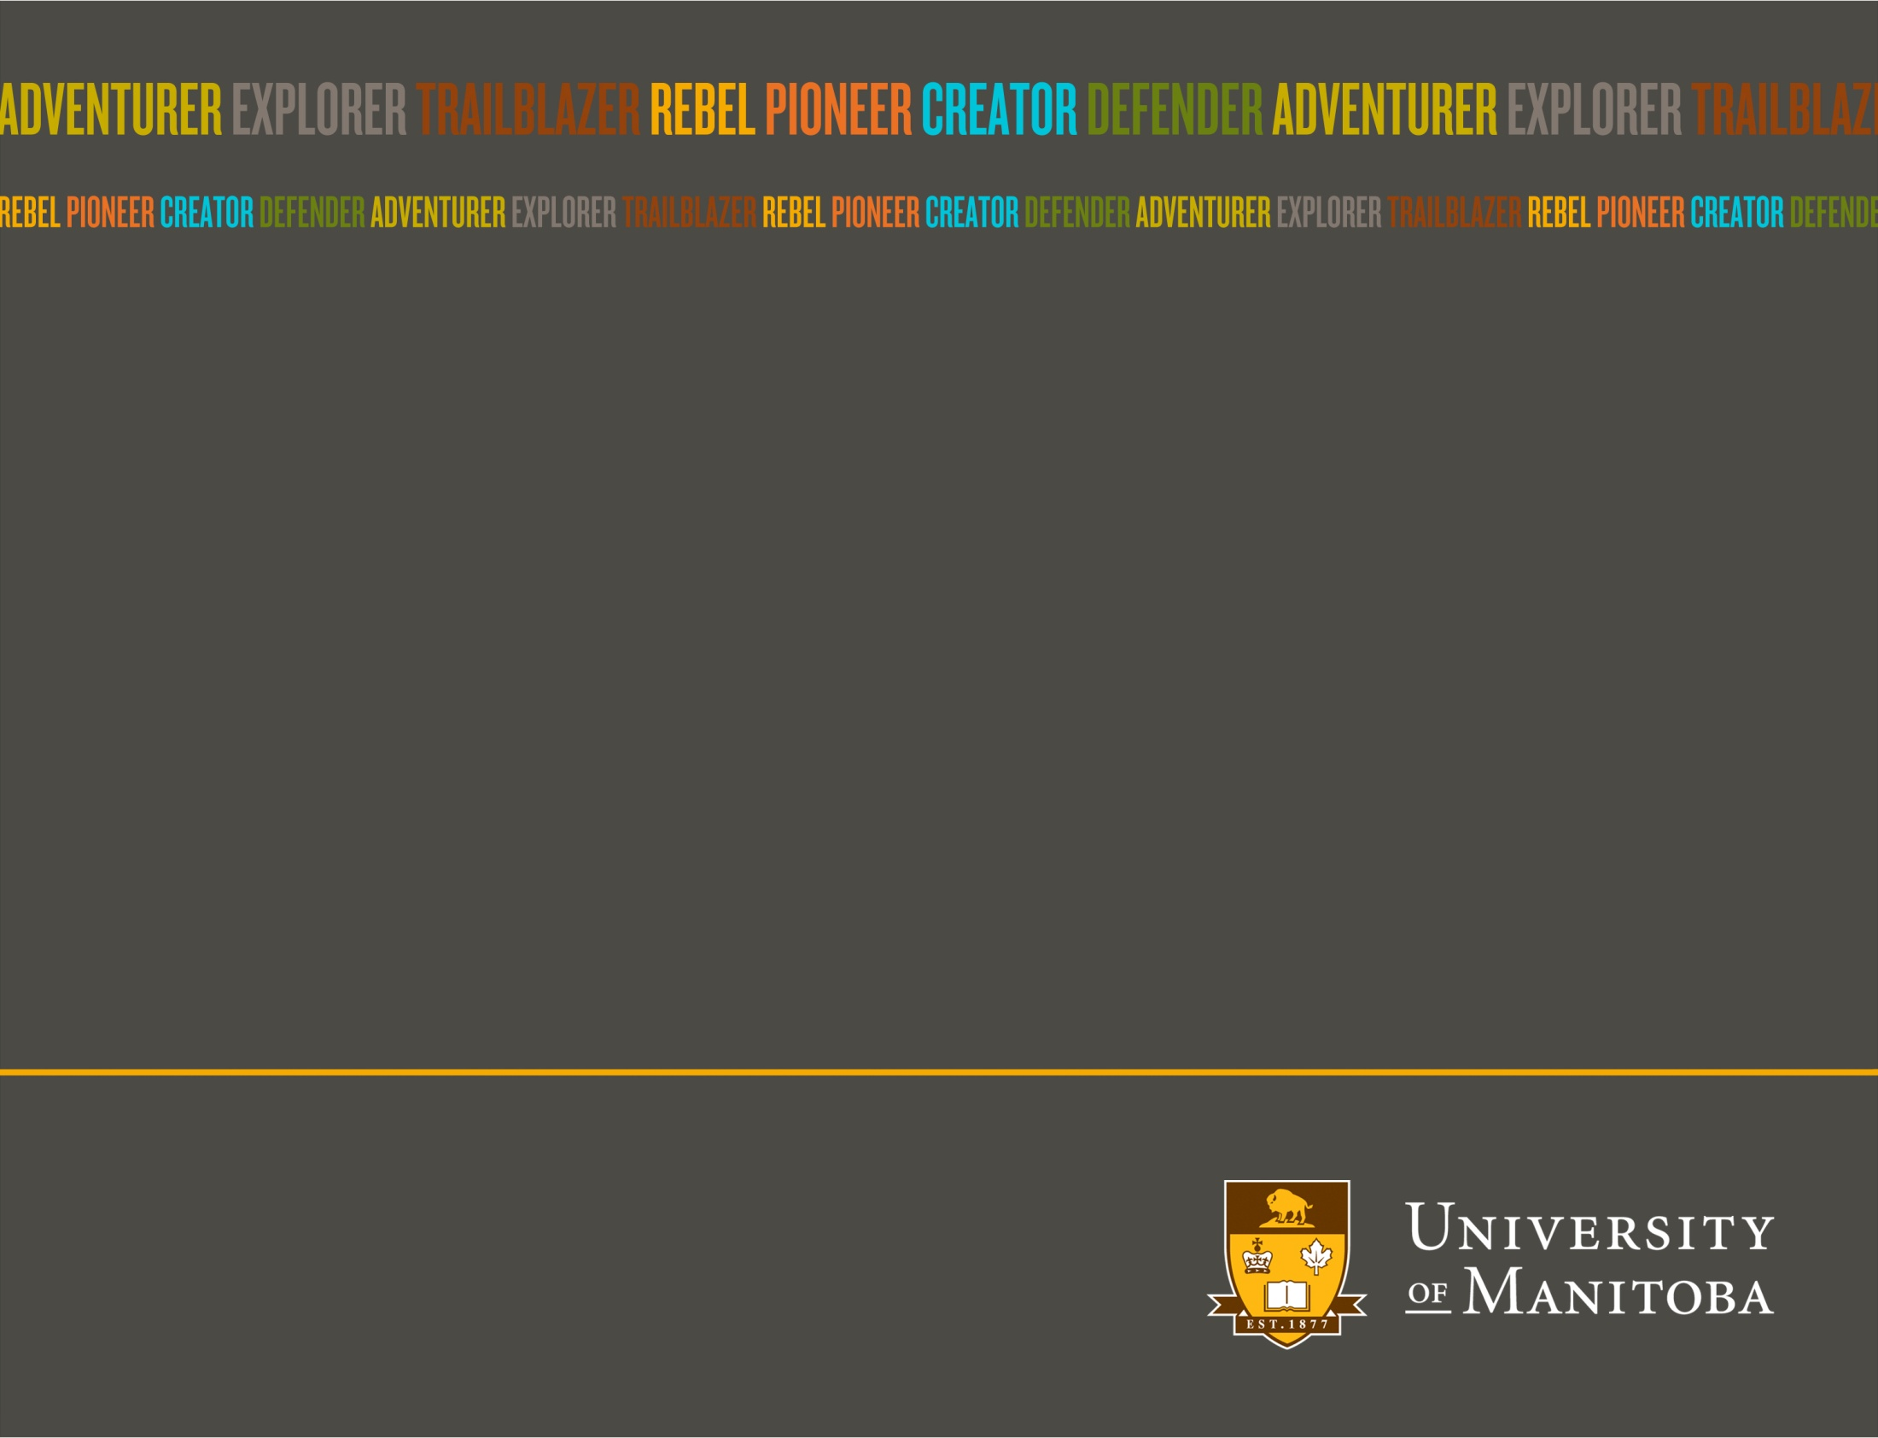

Lake Winnipeg Basin Information Network

Slide 2
“Research cannot flourish if data are not preserved and made accessible.” (Nature, 2009)
Notes:
Organizations, including the federal government have demonstrated their commitment to open data through actions such as signing the G8 open data charter in 2013.
As part of the G8 commitment, the GOC committed to a pan-Canadian open data strategy - Open Data Canada. This work will aim at increasing, aligning, and streamlining access to open data across the three levels of government. Additional commitments include:
Promoting the use of a common government open data licence in Canada
Working with non-governmental organizations, the private sector, and academia to support development and adoption of open data standards, and integration of data across jurisdictional boundaries.
http://open.canada.ca/en/g8-open-data-charter-canadas-action-plan
https://www.gov.uk/government/publications/open-data-charter/g8-open-data-charter-and-technical-annex

Slide 3

Notes:
Today, people expect to be able to access information and services, including science based information electronically when and how they want.
And almost all types of information has the potential to be data.
But there is another challenge we as scientists face in collecting and providing data – that is providing information that is not just PUBLIC BUT ACCESIBLE. We need to take the raw information and put it into a usable and understandable context so it remains RELEVENT
Data collection also costs MONEY
this includes RAW DATA, PROCESSED DATA (data produced when raw data has been calibrated or corrected), DERIVED DATA (data that present a summary or specific view of the raw data), and TEXTUAL DATA (the publications which result from a research project, or the TEXTUAL DATA like bibliographies and field notes that form the basis of that research project).

Slide 4

Notes:
How much money goes into the planning, preparation and execution of your data collection and analysis every year?
How do you store it so the data keeps its meaning? (ie metadata so you know WHO sampled WHAT the project was) and how do you keep it RELEVANT?

Slide 5
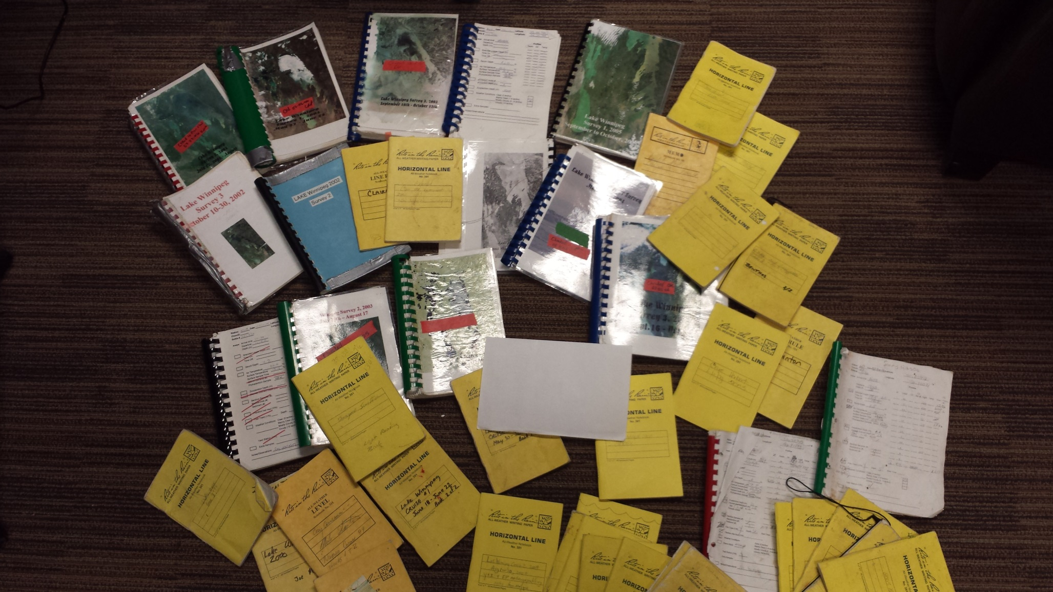

Notes:
This data may be PUBLIC, but they’re not accessible or understandable to an average user.
Scientists are not rewarded or paid extra to have a data management plan as part of the data collection process or for the time it takes to store data. But the high cost of the loss of that data including loss of metadata to keep data relevent- is also not taken into account when research programs are planned.
So, to address this, the LWBIN does 2 things:
1. Provides tools to give users the power to share and visualize their own datasets
2. And the ability to view data in a broader context – thereby increasing the data’s relevance and value. We do this by providing data products – Mashing up multiple individual and independent data sets
This 2 fold approach ensures your RAW data is stored safely for long term use, BEFORE it loses context (metadata is stored with it), and by leveraging the power of additional datasets you increase the value of your data
How do we accomplish this?

Slide 6
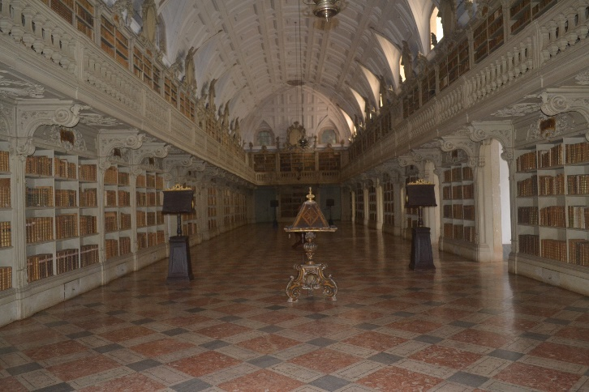
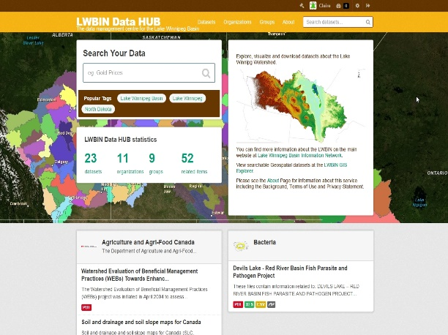
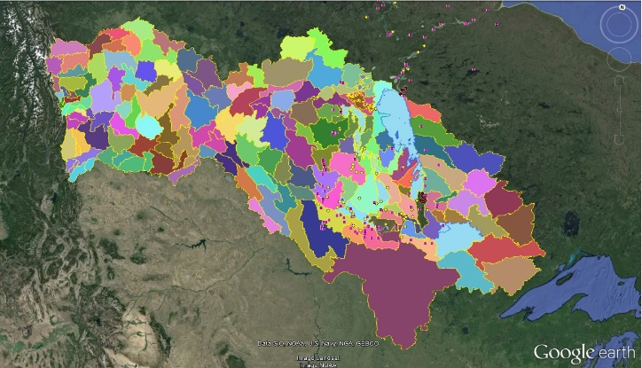

Notes:
This is a basic outline of our Data lifecycle management and Governance strategy
We use 5 databases on 4 servers :
The Data Repository (SQL Server) stores the data in original format
By applying basic QA/QC (data flags, metadata standards-GOC,G8 and ISO) we can extract, transform and Load datasets in appropriate formats for our data Server (CKAN) or Geoportal
The Data Server acts as a HUB for users to view digitized data, as well as data from the geoportal or the open access bibliographic repository
Our data architecture structure allows users to access datasets using the dataHUB, the geoportal or the bibliographic repository
The workhorse behind the data architecture is the SLQ Server data repository
DataHUB – CKAN
Geoportal – ArcGIS
Open Access Bibliographic Repository – Mspace
User Engagement: Webpages, Image gallery
Original data Repository – SQL Server
The LWBIN uses 5 databases
SQL Server databases– (Raw data & GIS databases)
CKAN (postgres)
LWBIN website (2) – Wordpress, coppermine,
And 5 Servers – migrate to 4:
CKAN – (LINUX)
Open Source Bibliographic repository - Mspace (maintained by Libaries)
Geoportal - GIS data server (Windows)
Current LWBIN Server (Windows) (will be migrated to the LINUX Wordpress server)
LINUX (new website and current image gallery)

Slide 7
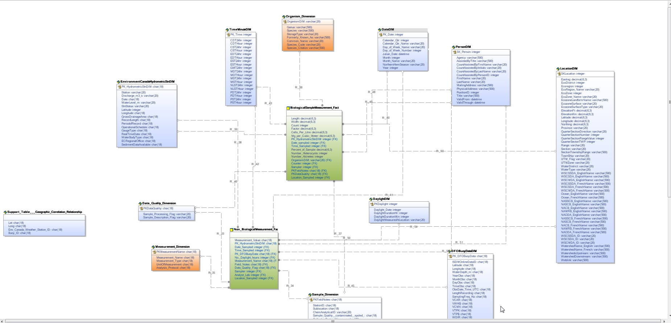
Notes:
A Dimensional Model to store data in its raw format while ensuring metadata is attached and with some basic qa/qc flags
By integrating the work of multiple researchers, we can use our collective intelligence to map out our ecosystem.
With access to a much larger and complex dataset, users will be able to explore connections that were never before suspected

Slide 8
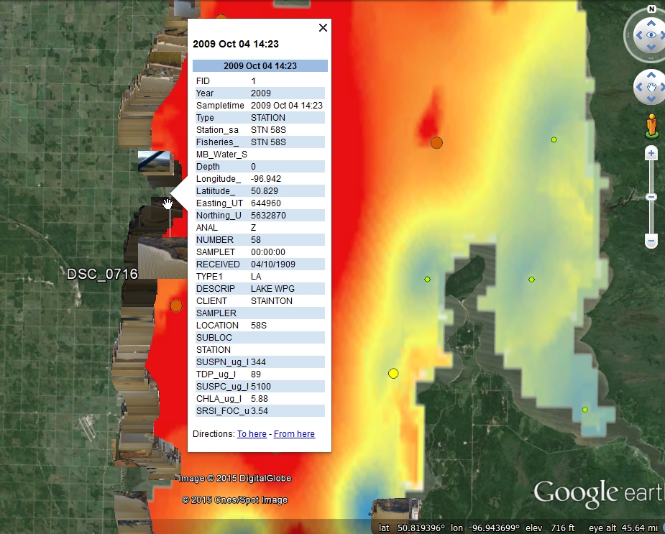
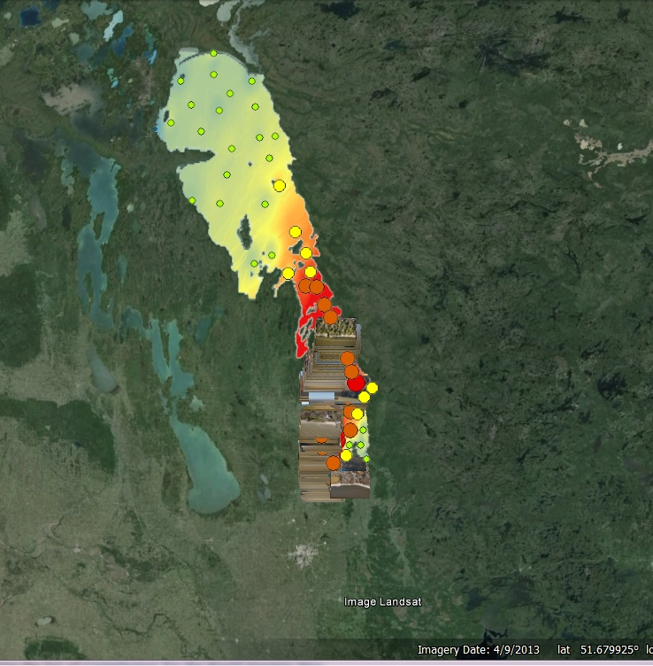
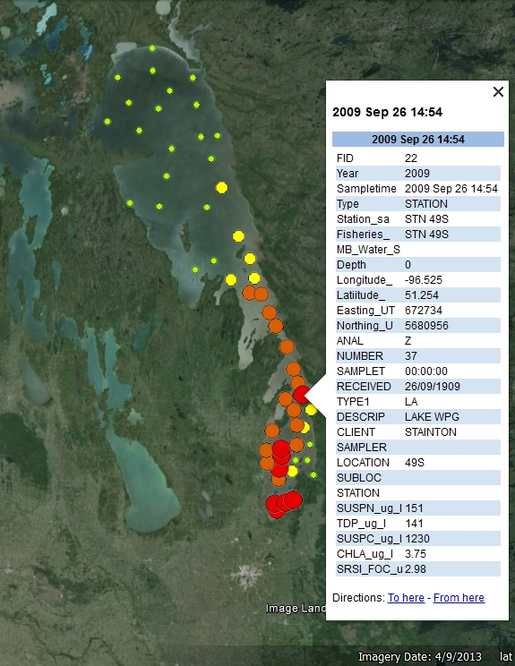
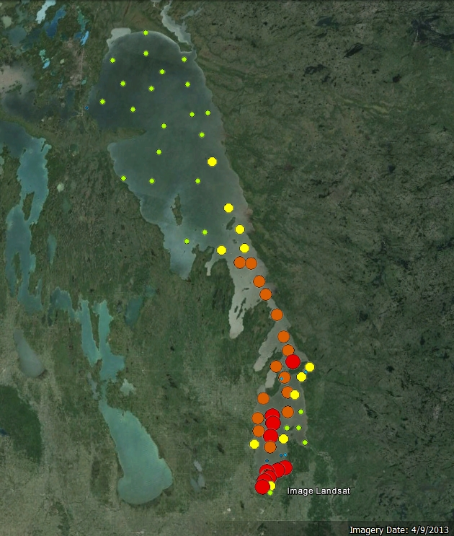
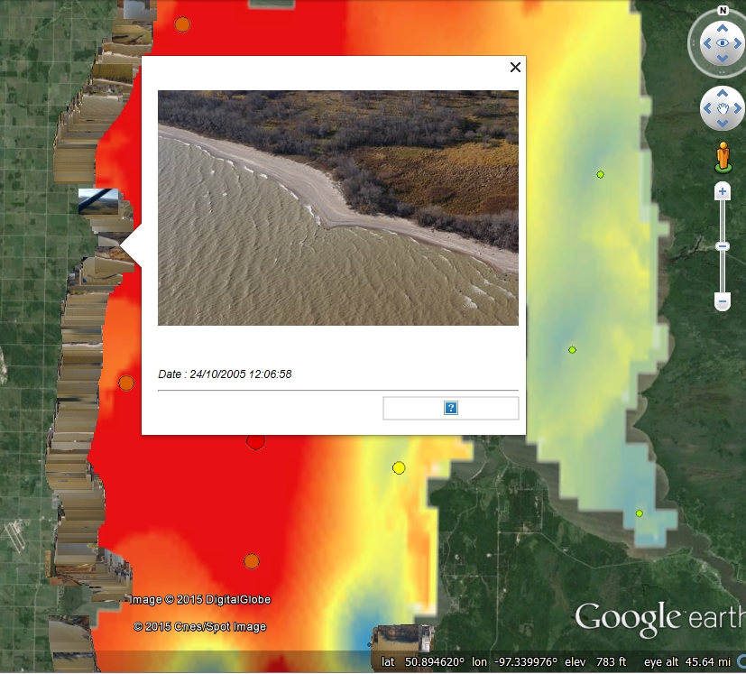
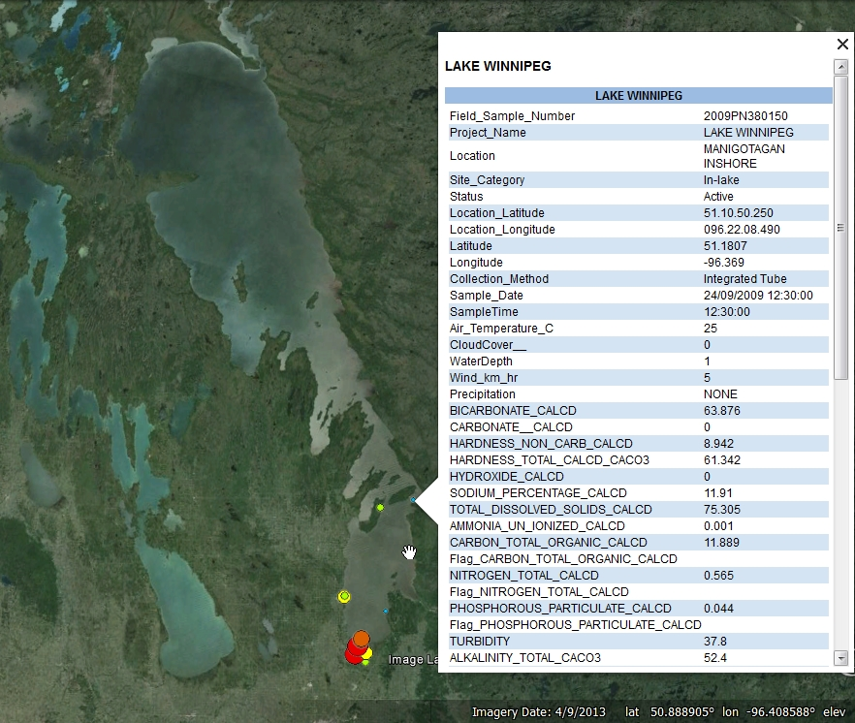
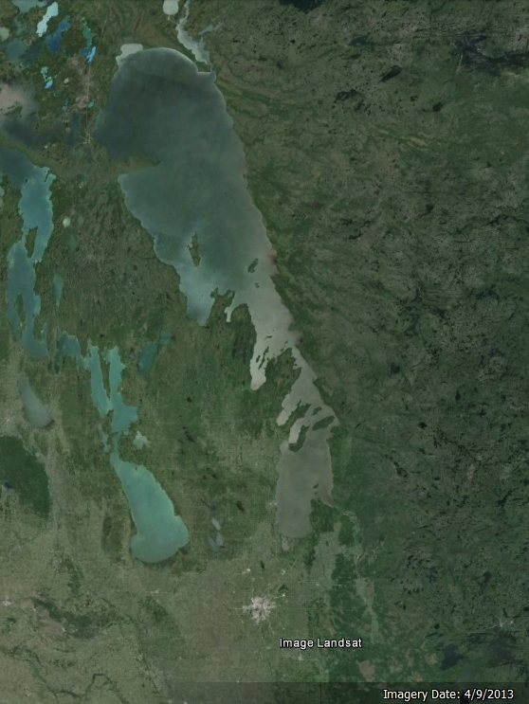
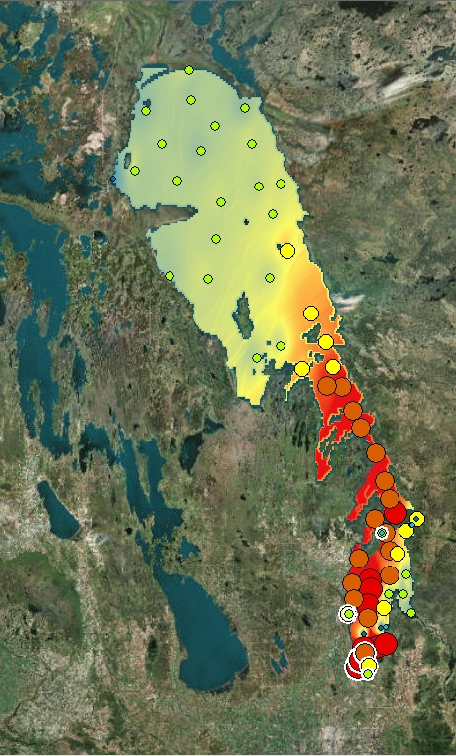
Notes:
In this first example, we will take a series of layer files downloaded from the LWBIN and overlay them in google earth.
Add layer 2009 turbidity data from EC
Provide data from an additional user – Fall survey 2009 LWpg TDP chemistry (Namao)
Both layers together give us a more complete picture of nutrients in the lake.
Add layer files developed from gis algorithms to see if station data can be used to estimate the tdp over the entire lake
Provide some visual context – DFO aerial survey images form 2005
Get an idea of what the shoreline looks like
See what the shoreline looks like in near stations sampled

Slide 9
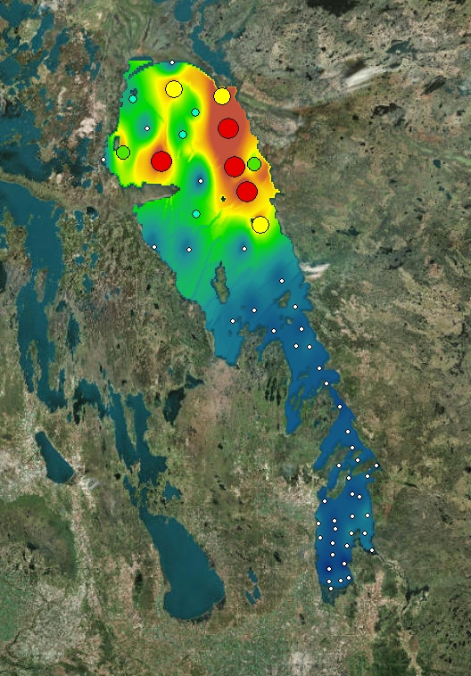
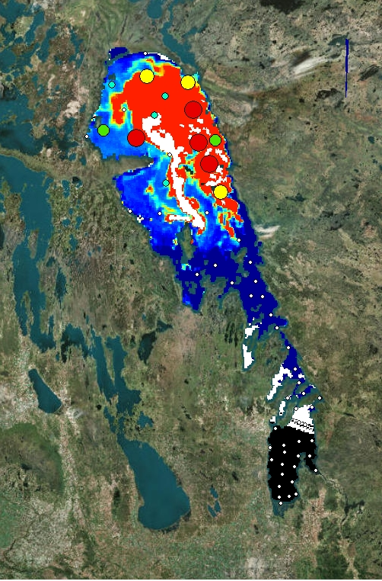
Notes:
Can also do the same kind of layering using chlorophyll data (station and idw) and satellite images that use programs to calculate chlorophyll a concentration (C-core) from surface water.

Slide 10
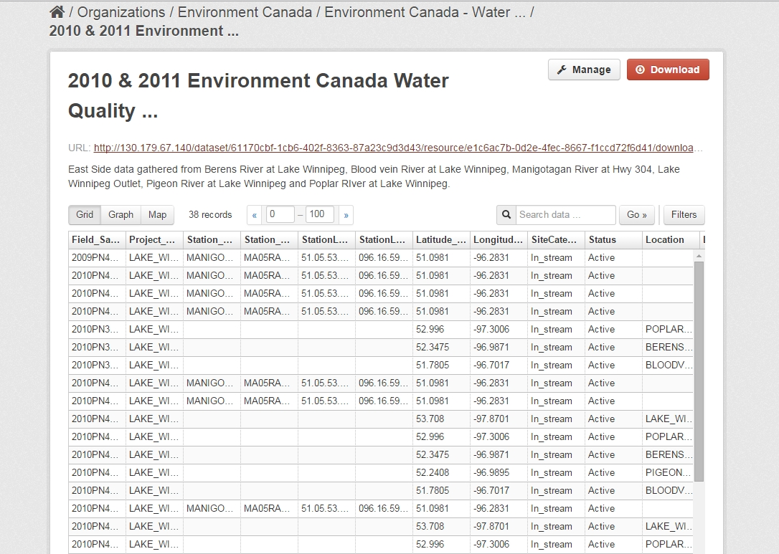
Notes:
Under the G8 charter, one of the Goc’s mandates is to release high-quality open data that are timely, comprehensive, and accurate and in their original, unmodified form;
We accomplish this by preserving the original data in the repository, and using ETL process to allow users to view the data in a spreadsheet.

Slide 11
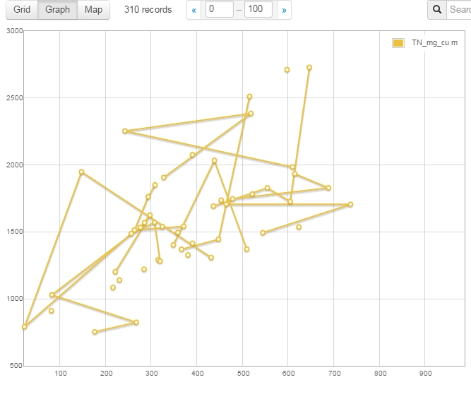
Notes:
As a graph
This is a graph showing TN vs TP (mg/cu m) in the lasalle watershed for 2009. TP is on the bottom axis.

Slide 12
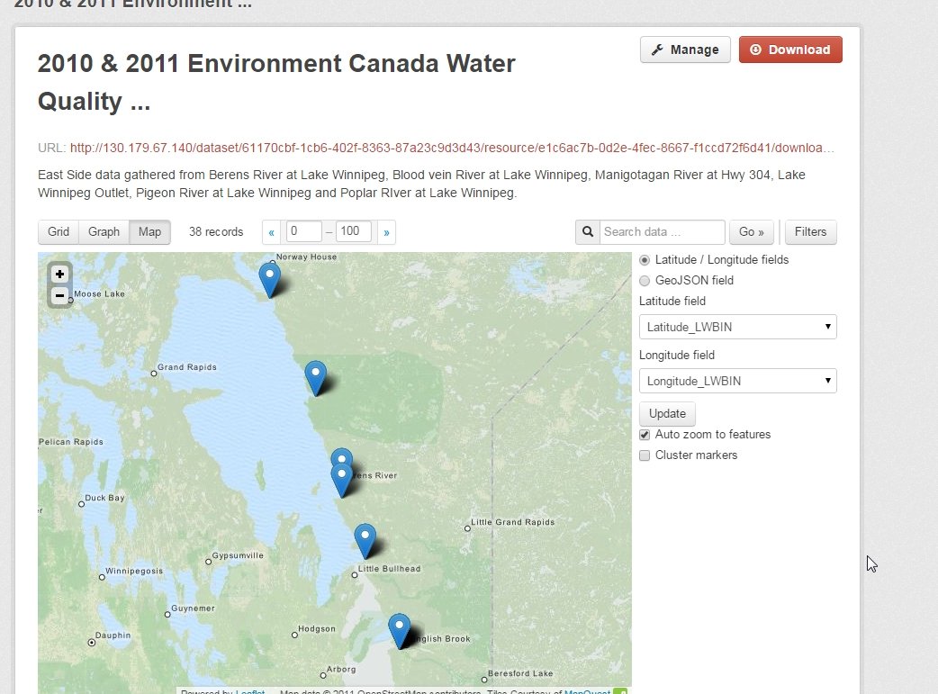
Notes:
Or as a map of locations

Slide 13
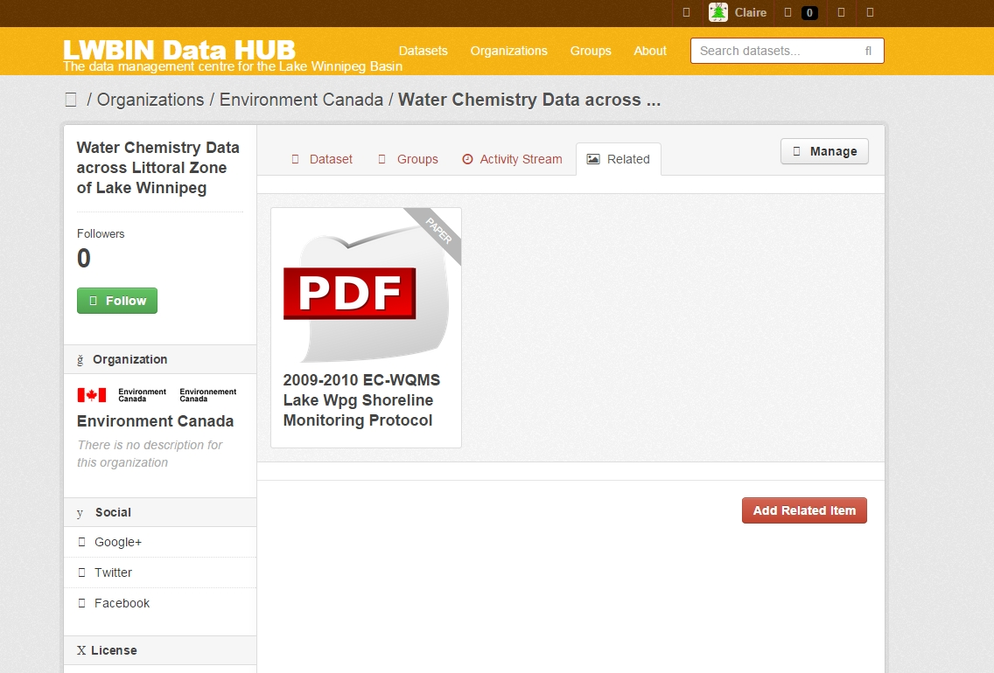
Notes:
Additional related information is stored in the Related tab – can link to pdf, website or UM open access library
Datasets can also be kept private to be shared within specific organizations – have only metadata available, to allow for embargo periods for publication (ex. Genevieve)
All Datasets are assigned a DOI – allows data to be permanently citeable (like publications)

Slide 14

Notes:
Currently loaded into the Data HUB is a small subset of all the data the LWBIN actually holds.

Slide 15
18 + Organizations
Over 150 datasets
  Spanning 1960 – 2011
  Physical
  Chemical
  Biota
  Spatial
Hardcopy
Notes:
Actually hold:
data for 18 + organizations,
150 datasets spanning 1960 – 2011
Including Physical (bathymetric, temperature, depth)
Chemical – Metals, nutrients
Biota – Fish, phytoplankton, zooplankton
Spatial – raster, vector, eg. Hydrometric stations – us, canada, land cover
Hardcopy reports, documents
To be uploaded in Mspace
Scraped for data set information

Slide 16
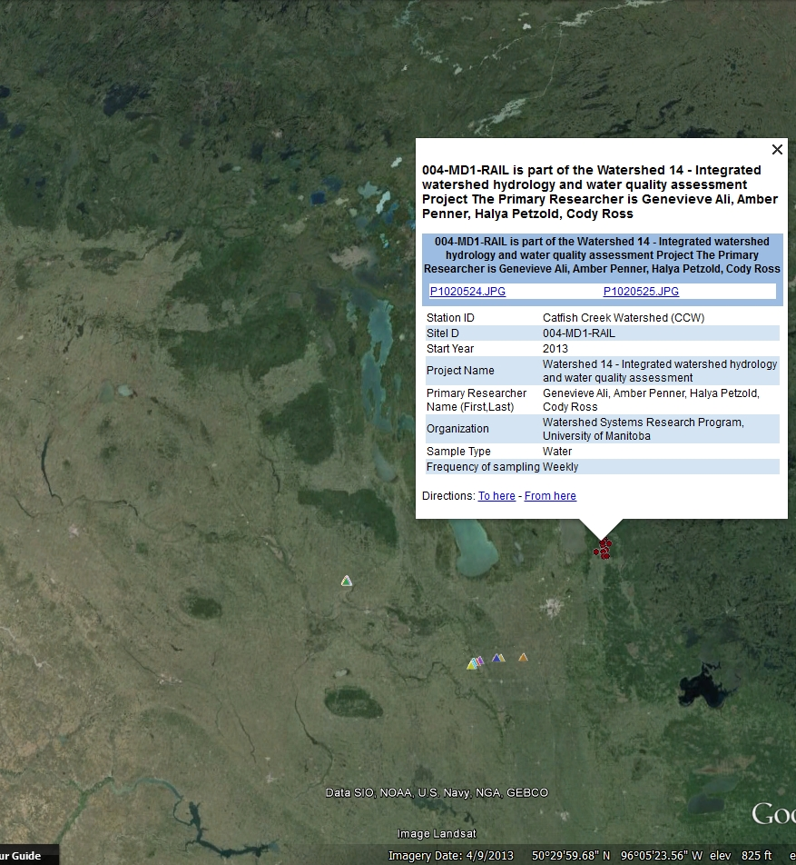
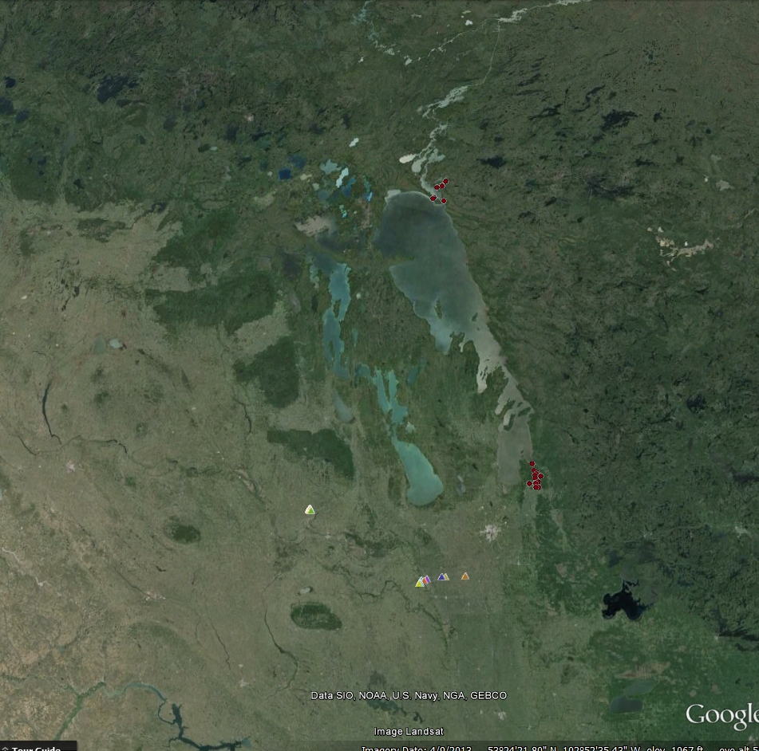
Notes:
When we provide open data, we share technical expertise and experience with each other and with other countries across the world so that everyone can reap the benefits
In this second example, we are combining metadata only information with additional data layers.
shows samples sites from University of Manitoba WSRP students
Student research sites have PI name and student name, along with some sampling info and associated images.
Some sites were added via a mobile application.

Slide 17
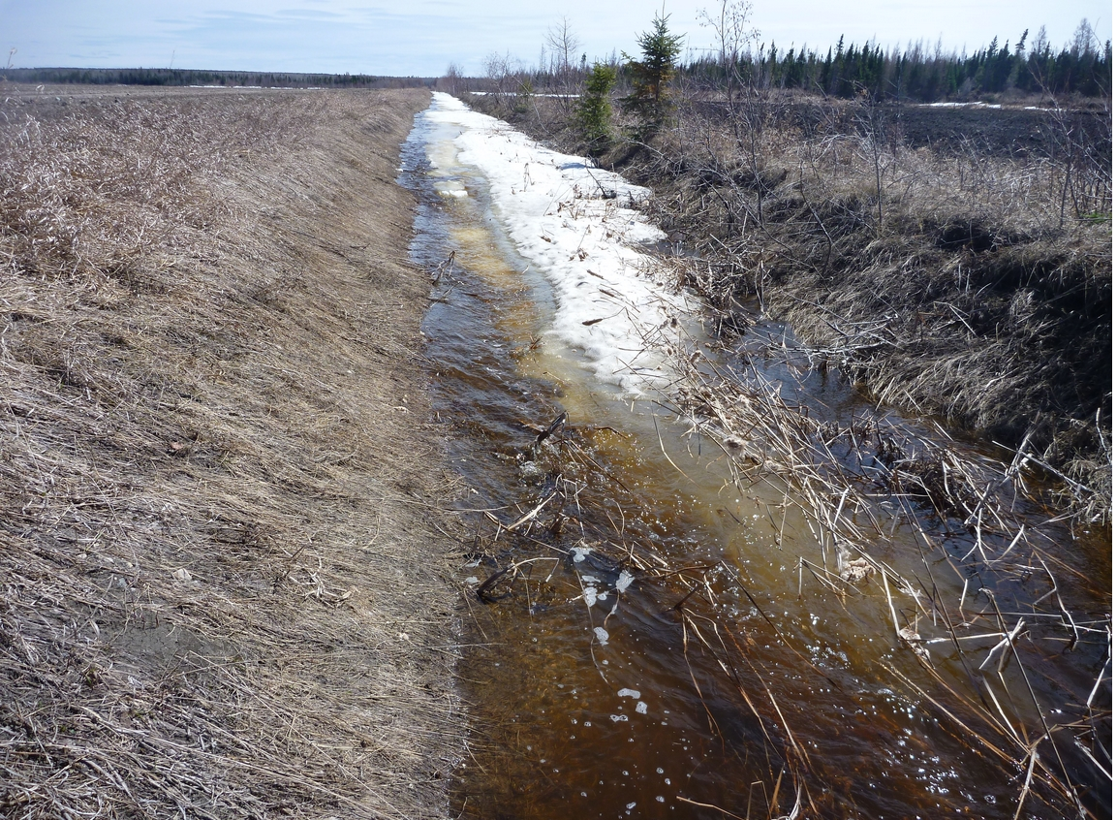
Notes:
You can click on the image links to view a picture of the actual site

Slide 18
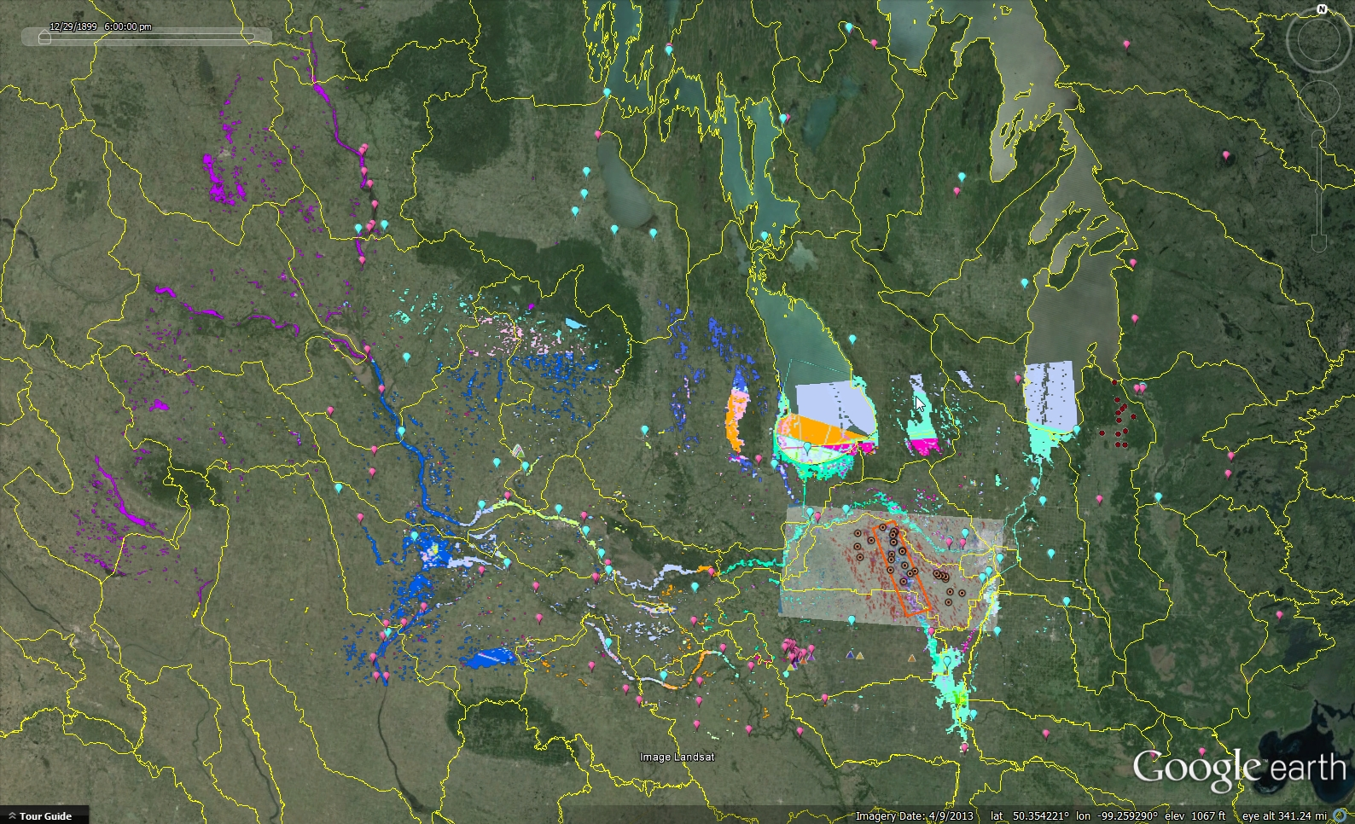
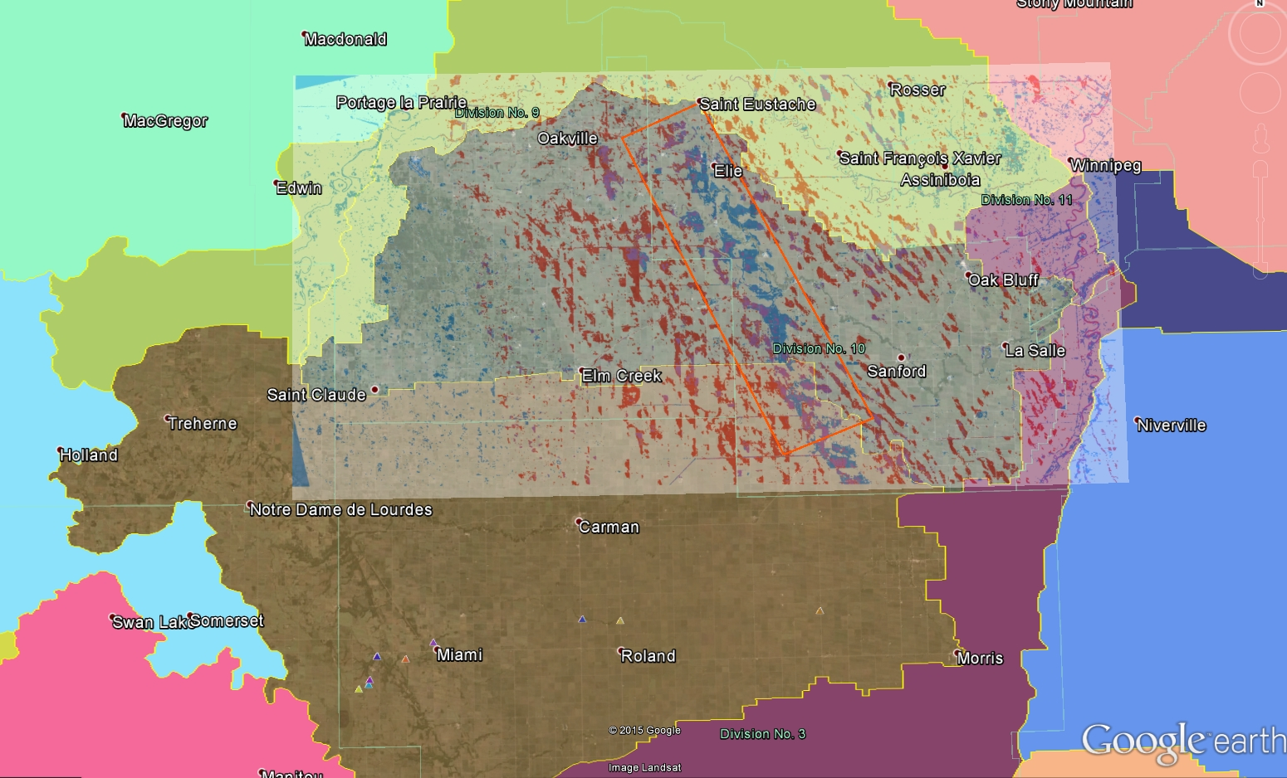
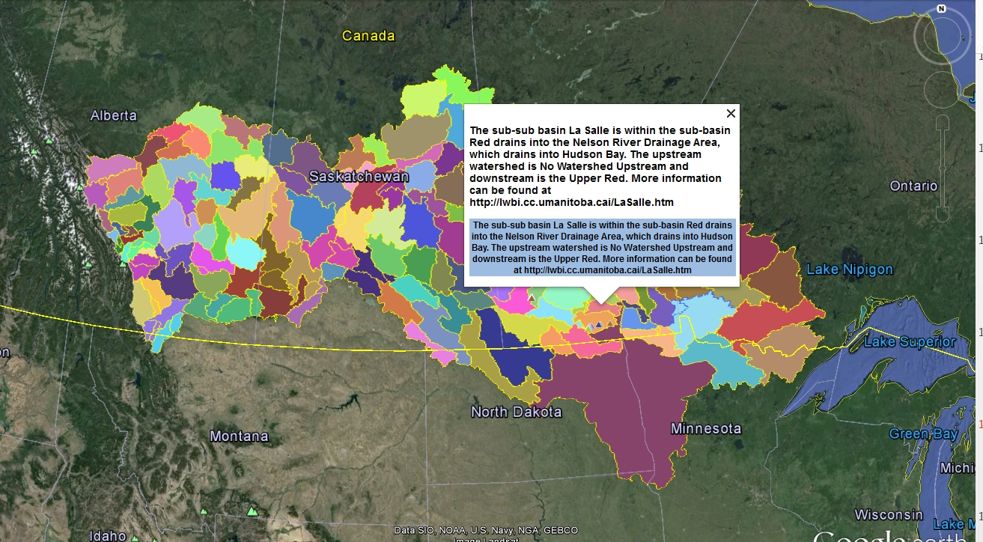
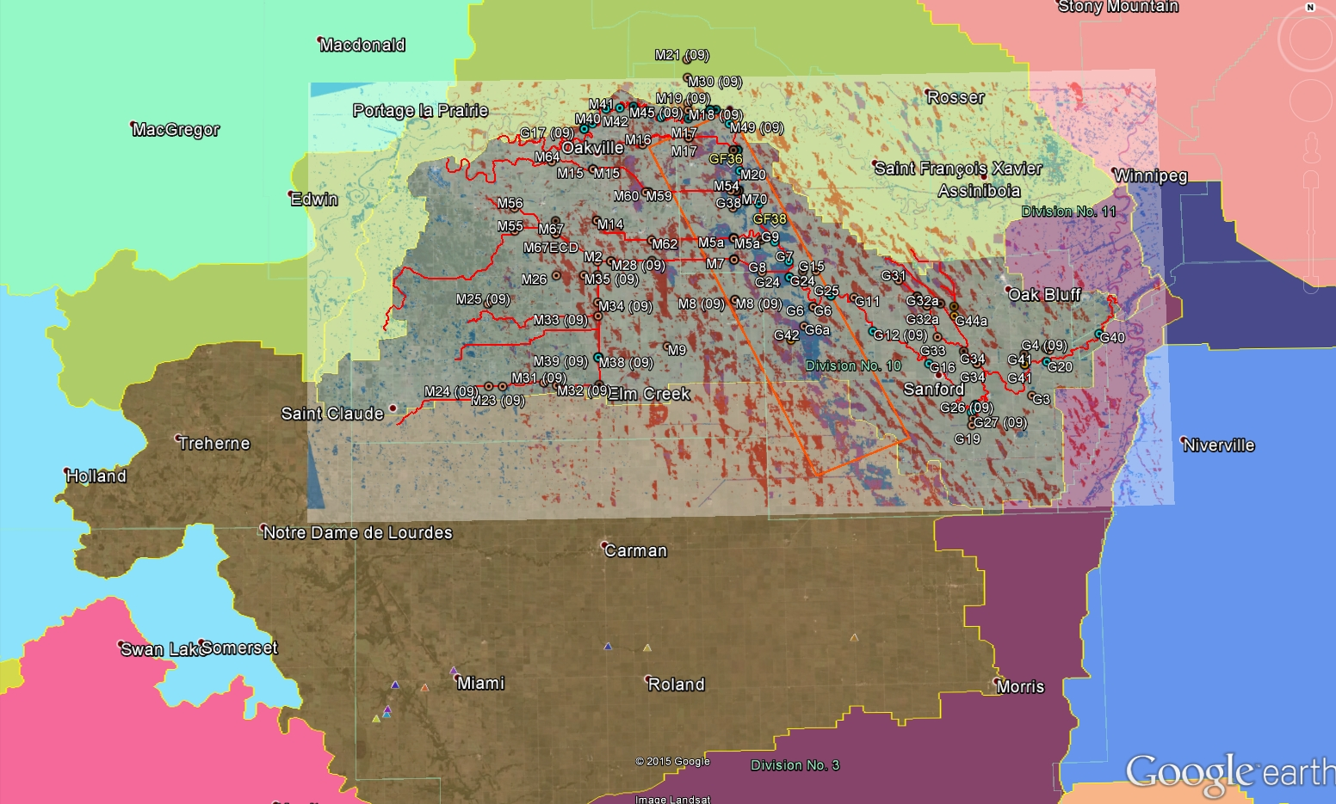
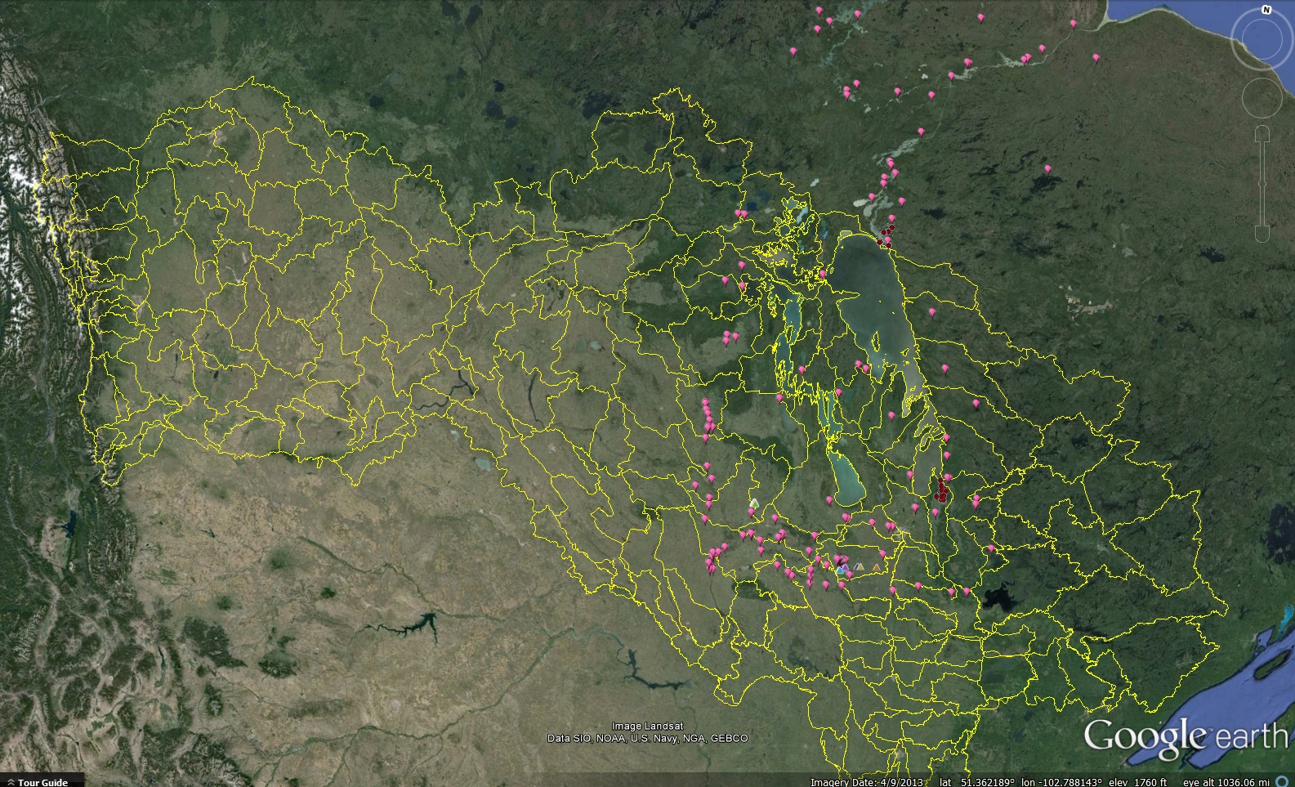
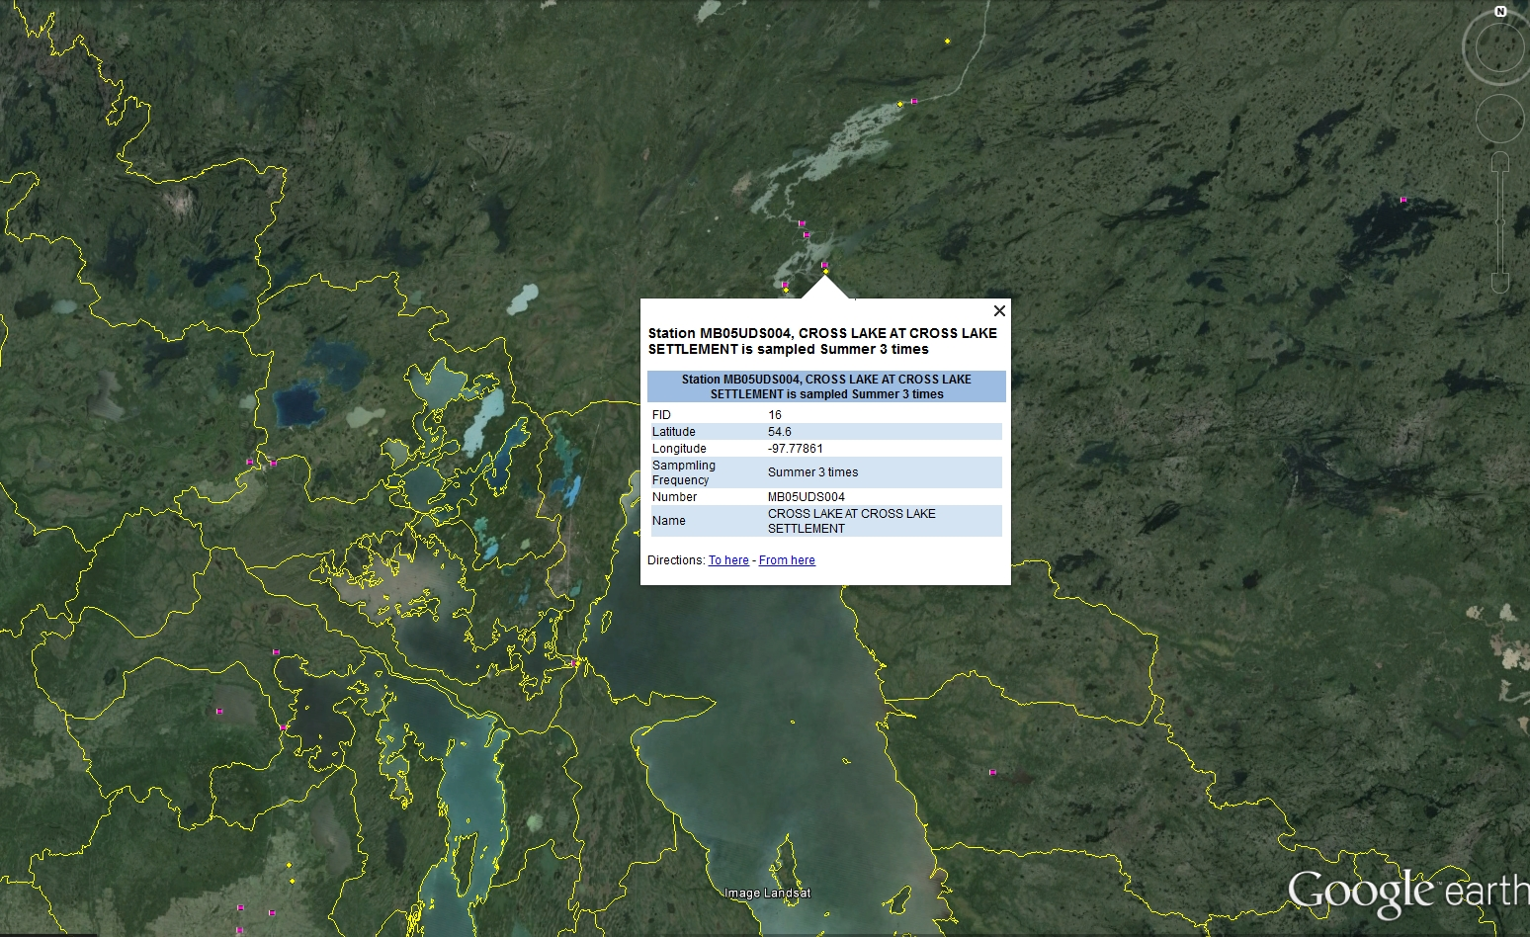

Notes:
So what if you take those few stations and add another layer - satellite data (composite radarsat image of flooded areas during 2011 spring sampling in the LaSalle), showing April 8(red), April 15(blue) and flooding.
Then add additional stations from another research project.
and you could keep doing this – adding sites like the historical EC stations and the MB Provincial stations.
Simply by adding this basic information to a map, we can see potential data sharing opportunities.
And just for fun, the ASR Flood extent for 2011 – Radarsat (These flood extent polygons were generated from Sensor: Radarsat-2, Beam Mode: Standard 1 (S1), Orbit Direction: Ascending, and Polarisation: HV. The minimum polygon size is 5 ha. Emergency flood maps generated in near real time).
In order to build understanding, the LWBIN engages users at all interest levels. Now this final map you see is a watershed map layer from the KYW Interactive map application in the LWBIN. It allows users to drill down deeper into watersheds of interest to find out additional information, by providing links to supporting information pages. For example

Slide 19
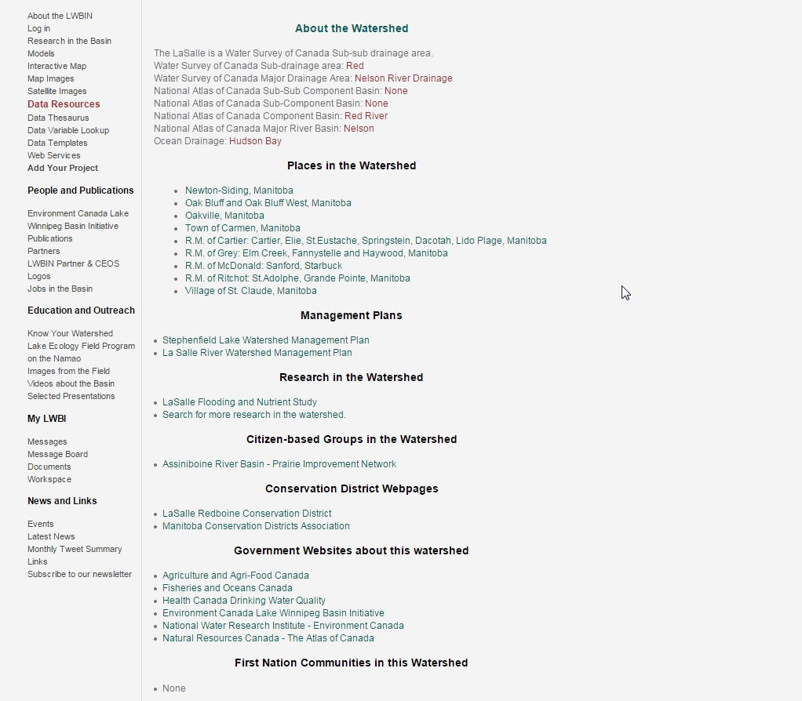
Notes:
-the About page for the LaSalle Watershed
include information about watersheds upstream and downstream and links to additional information

Slide 20
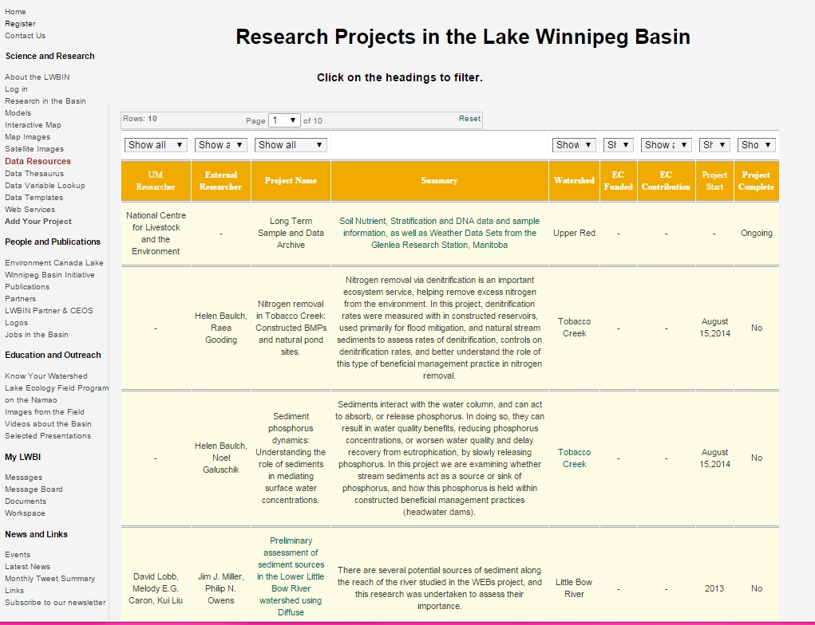
Notes:
Additional information pages provide Searchable tables of all the research projects within the basin

Slide 21
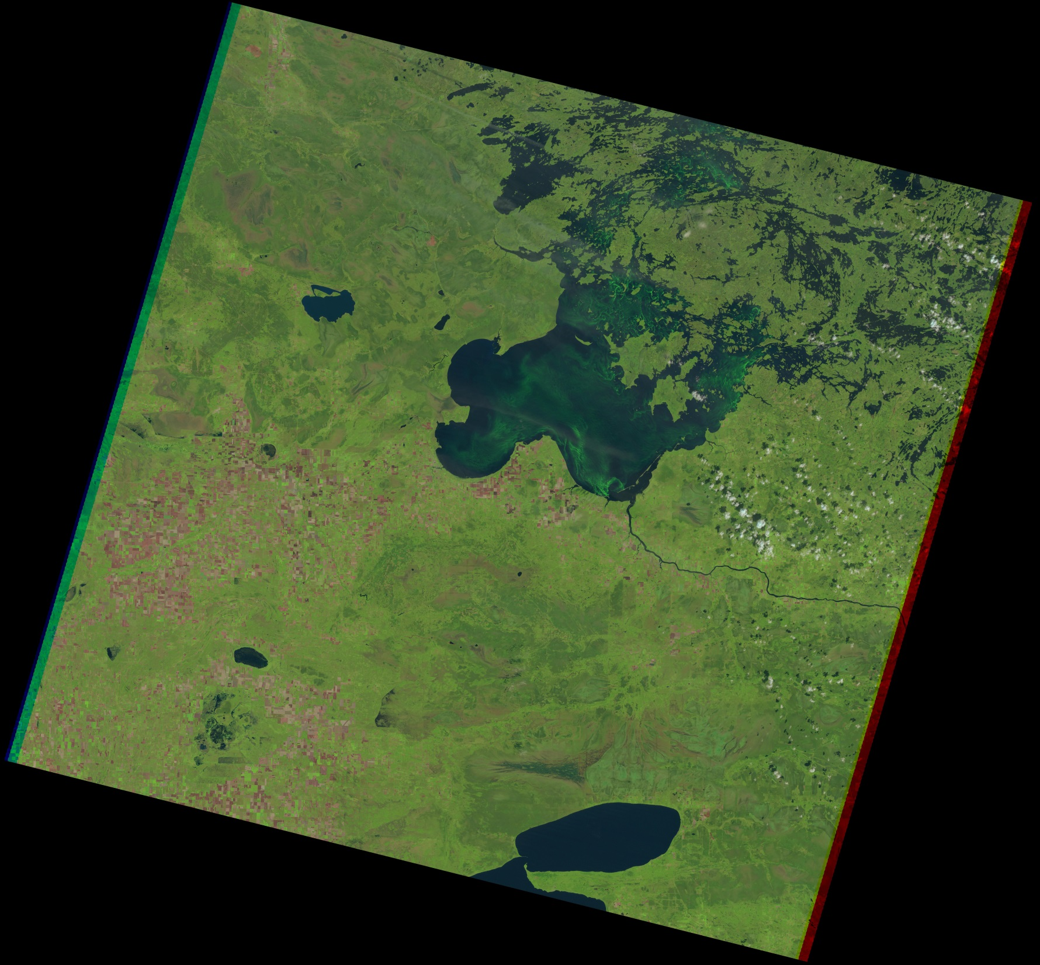
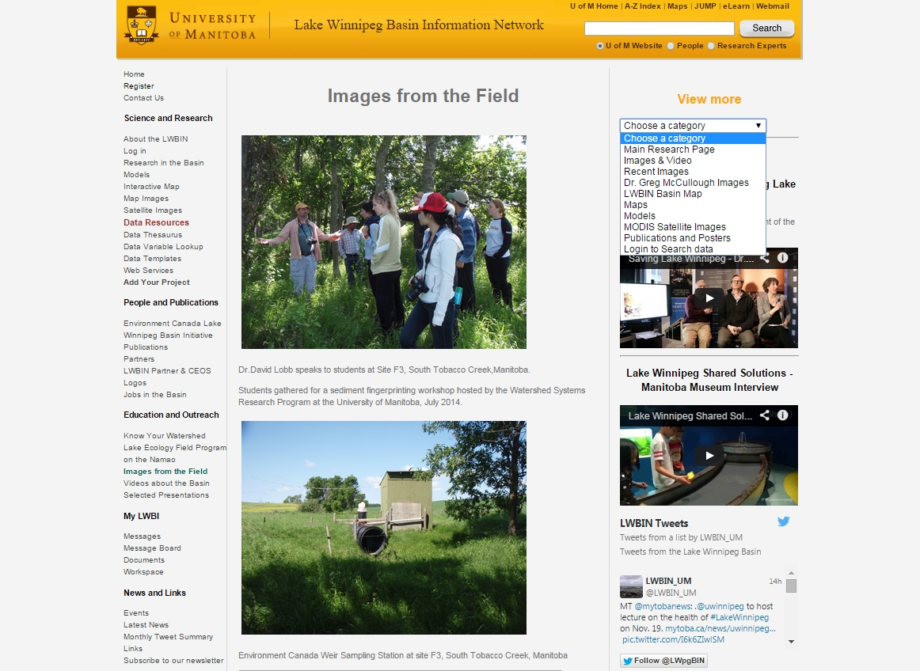
Notes:
and image galleries allow users to view picture of activities in the basin, or view satellite photos or videos .
LOW, Aug 28, 2001

Slide 22
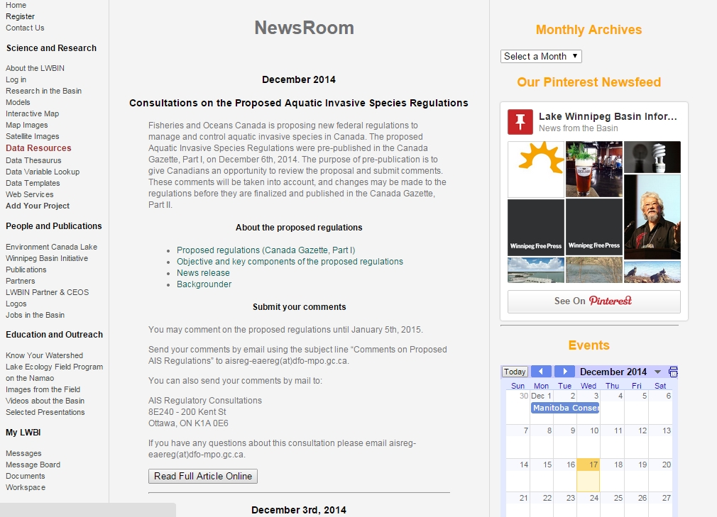
Notes:
We also connect users in the basin by posting News articles,

Slide 23
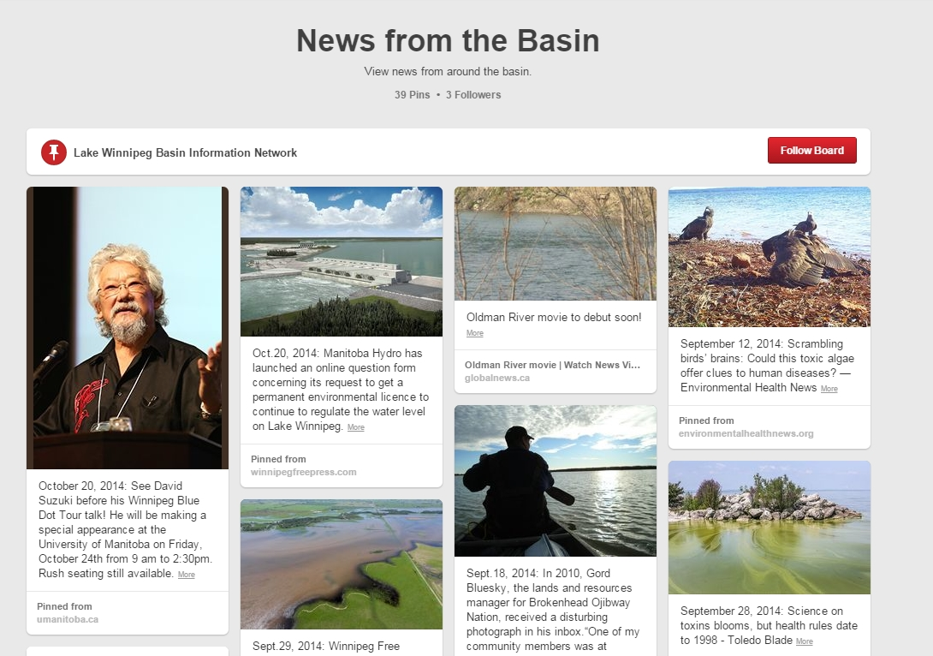
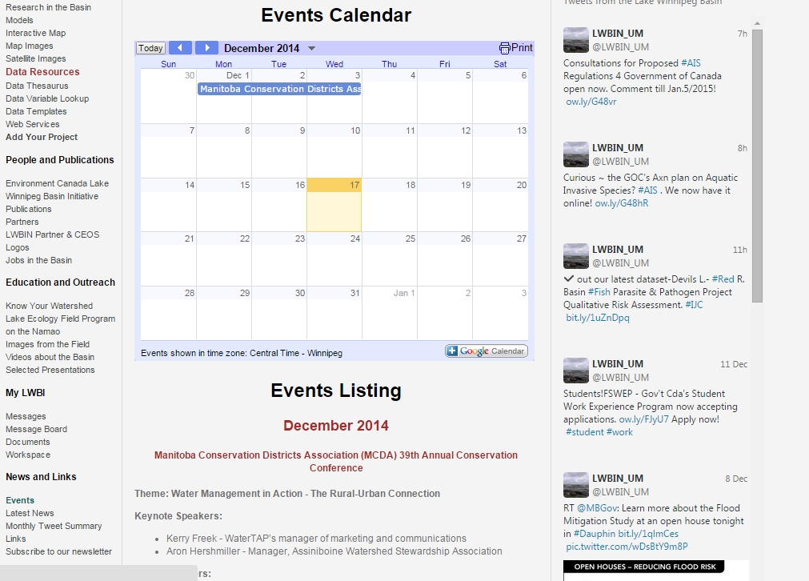
Notes:
events about activities in the basin and through our social media accounts (twitter, pinterest)
A listserv allows users to quickly send information of interest to a large audience.

Slide 24
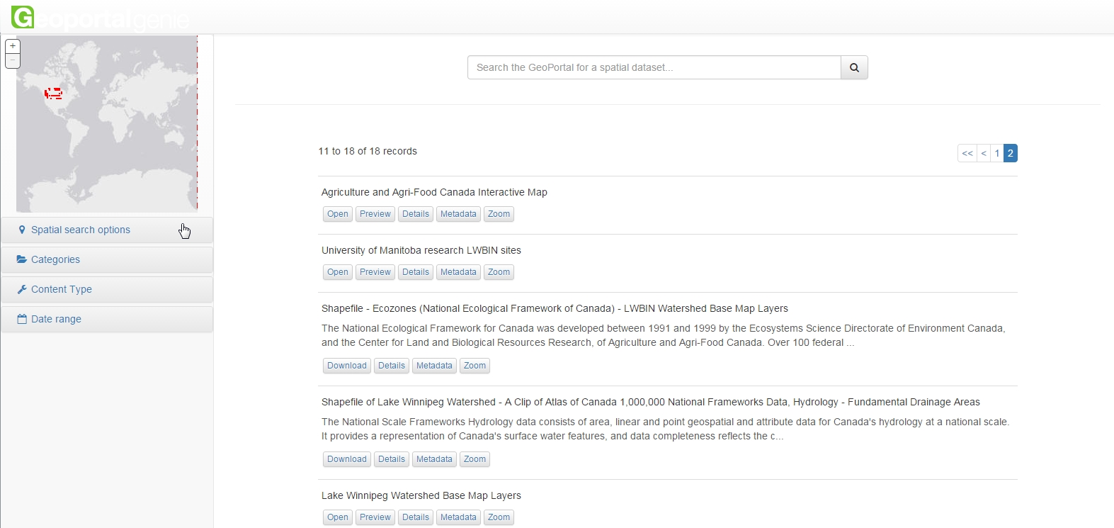
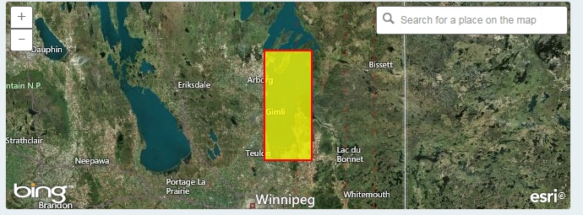
Notes:
Our searchable geoportal interface allows users to search for information using interactive maps.

Slide 25
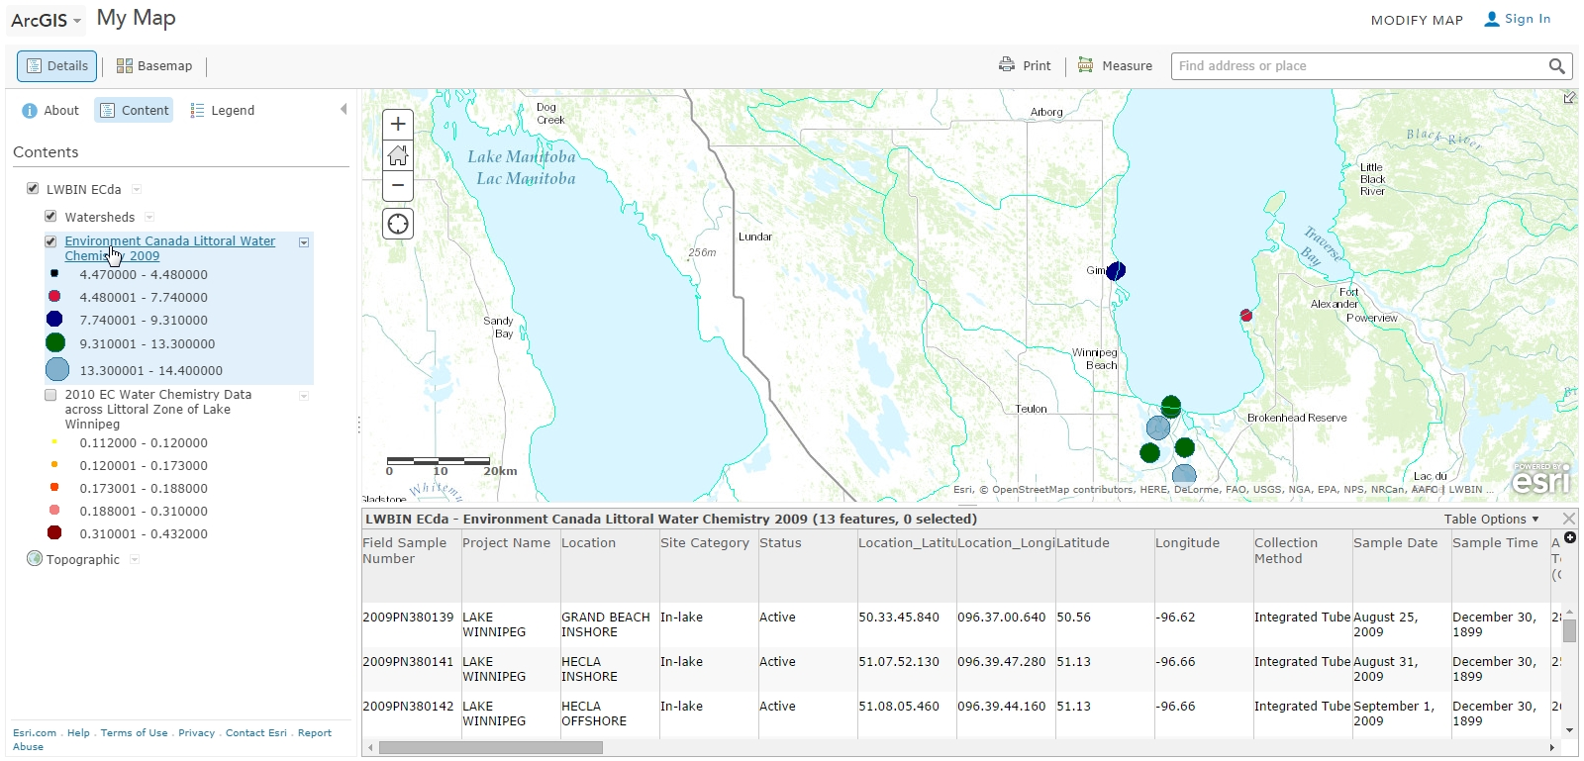
Notes:
And use advanced mapping applications to visualize and download data (change mapped parameter and can filter)

Slide 26

Communication
Understanding
Transparency
Templates
Architecture
Digitization
Notes:
By amplifying our collective intelligence, we enable individuals to develop new insights and innovations that can improve our understanding and help to improve the flow of information
Tip of the Iceberg
Communication
Connecting research including transboundary data flow
Understanding
Collective Intelligence to improve how information is shared and explore new relationships (Michael Nielson – Fulbright Scholar with PH.D in Theoretical Physics, Author, Quantum computing, Lives in Toronto)
Templates
Development of Protocols users can use to know what to request when contracting data collection.
Metadata – stand-alone
Architecture
Through data warehousing and maintenance (Qa/QC) we will provide better data integration.
The ETL (Extraction, Transformation and Load) scripts need to be developed
Adding to current datasets
Adding new datasets
Digitization

Slide 27
Until a broad audience can Know and Understand your data, the Work isn’t done

