Slide 1





Hudson Strait Inflow: Structure and Variability
Natasha A. Ridenour¹, Fiammetta Straneo², James Holte², Yves Gratton³, Paul G. Myers¹, David G. Barber⁴
¹ Earth and Atmospheric Science, University of Alberta, Alberta
² Scripps Institution of Oceanography, UCSD, California
³ Institut national de la recherche scientifique – Océanologie, Québec
⁴ Centre for Earth Observation Science, University of Manitoba, Manitoba

Slide 2
Goals:
Present the first year-round observations of the Hudson Strait inflow
Determine Hudson Strait inflow source waters
Estimate Hudson Strait inflow pathways within the Hudson Bay Complex
2

Slide 3
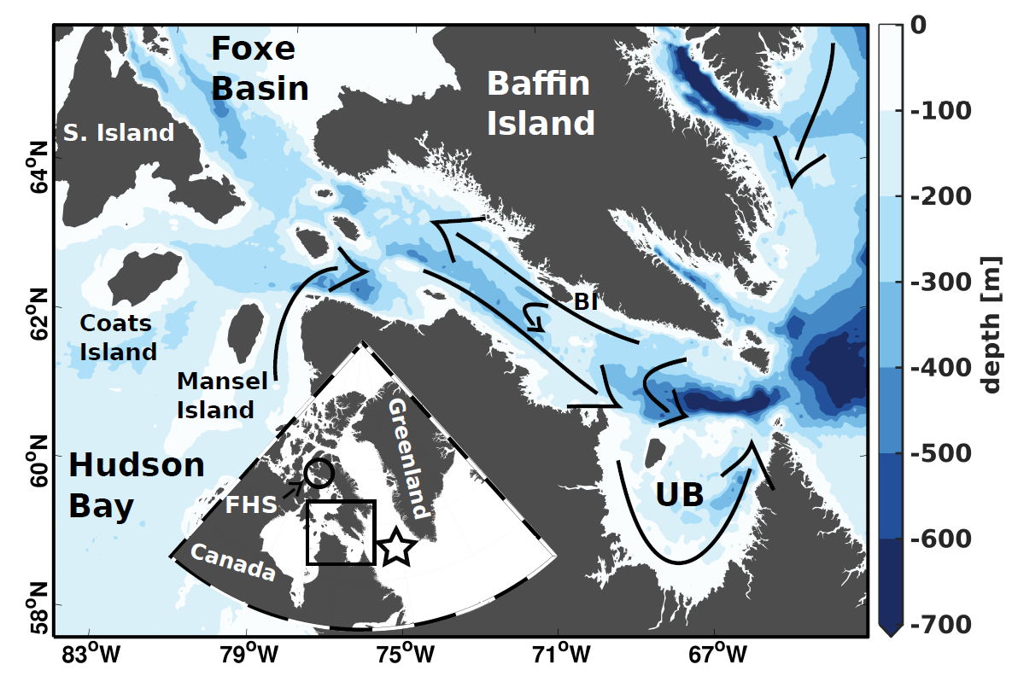
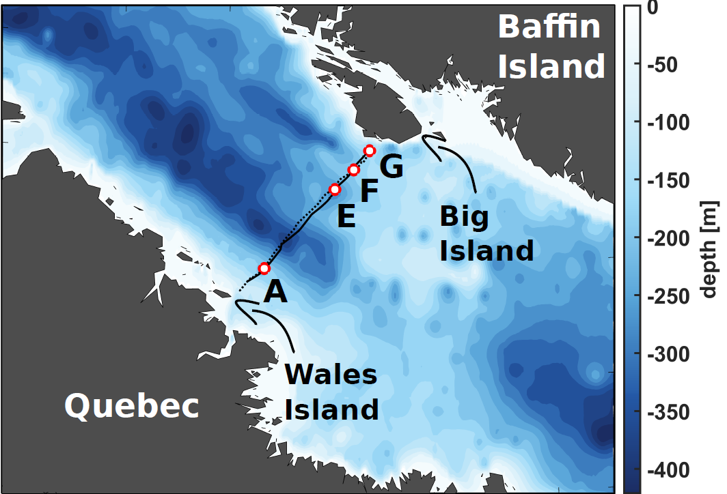
Flow in Hudson Strait
3

Slide 4
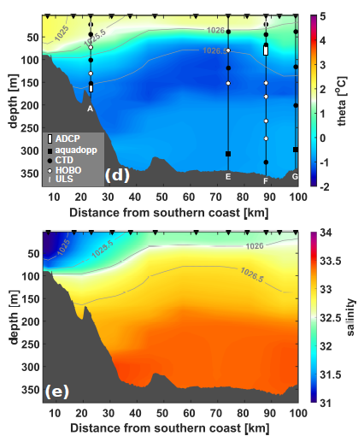
Structure across Hudson Strait
Stratified, warm, fresh outflow along the southern coast in September 2009
Cold, more saline inflow along the northern coast in September 2009
4
Notes:
2008-2009

Slide 5
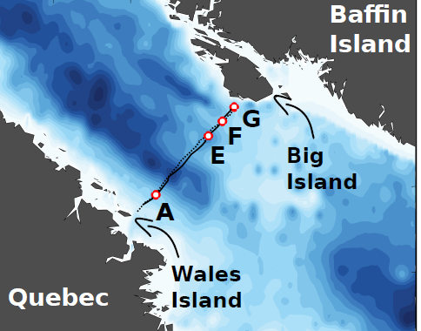
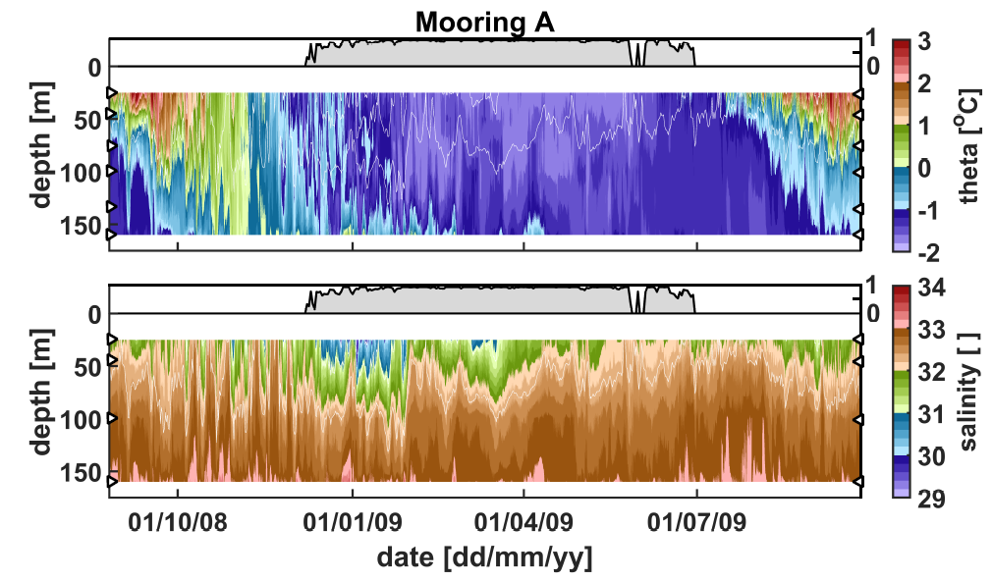
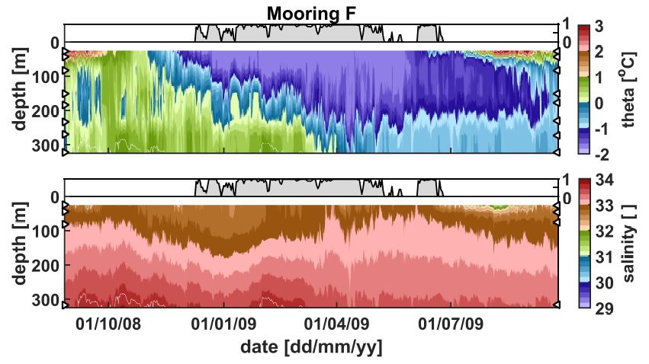
Comparing the outflow and inflow
HS Outflow (Mooring A)
HS Inflow (Mooring F)
Seasonal heating and cooling across the strait
Inflow salinity has reduced seasonal variability compared to the outflow (explained by the lack of river discharge)
5

Slide 6
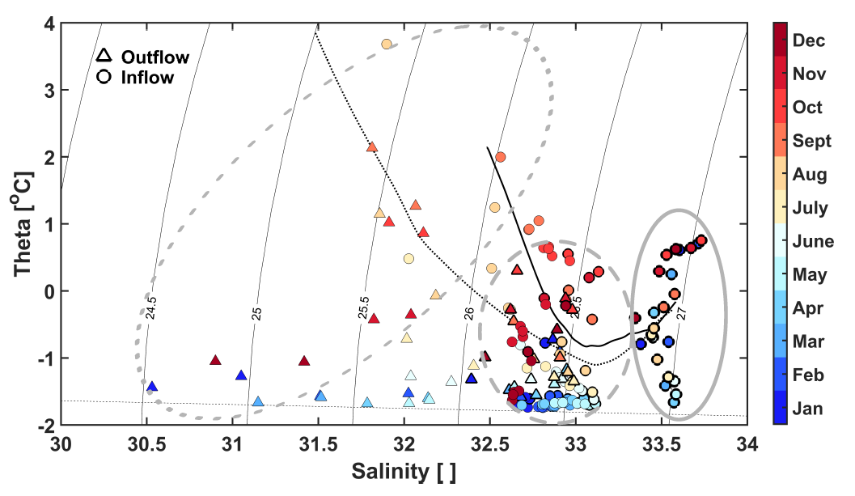
Waters in Hudson Strait
The waters in Hudson Strait fall into three categories
Surface waters subject to seasonal heating and river input
Cold waters with salinities between 32.5-33
Warm, saline bottom waters that are only found in the inflow
6

Slide 7
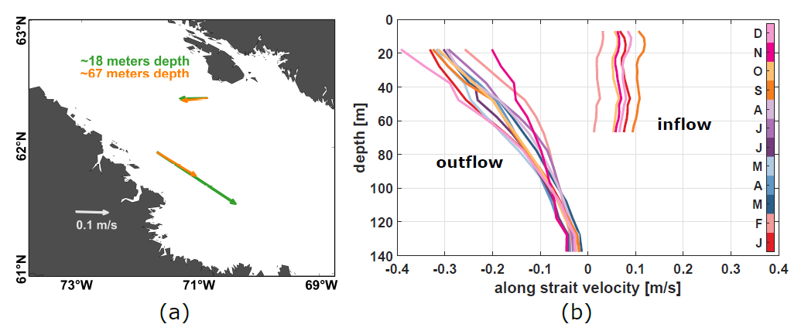
Currents in Hudson Strait
There were unfortunate circumstances that led to no or unusable velocity data
7

Slide 8
Currents in Hudson Strait
Strong shear in outflow, with seasonality at the surface
Inflow has weaker flow, with little to no shear, however, seasonality occurs throughout the top ~70 m
7

Slide 9
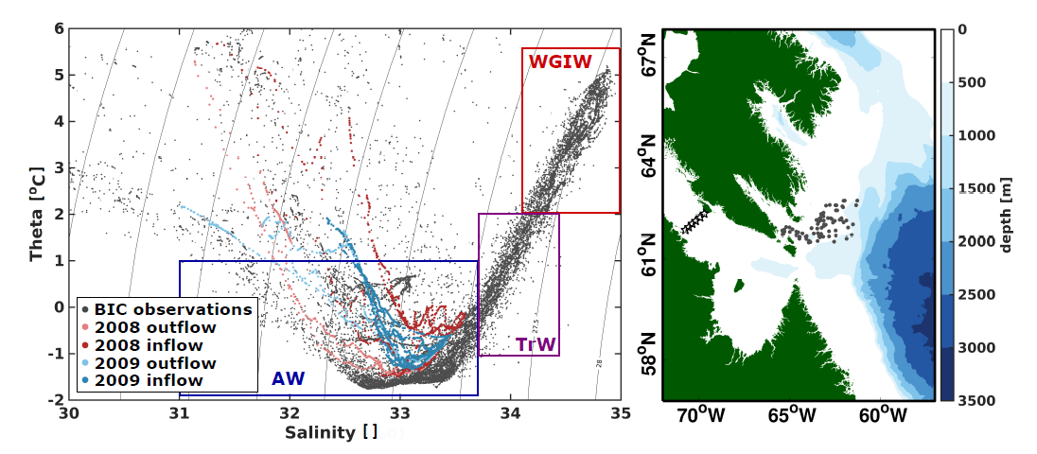
Source waters
Hudson Strait inflow stems from the Baffin Island Current
Hudson Strait inflow mostly Arctic Water
With deep waters having a small contribution from Transitional and West Greenland Irminger Water
8
Notes:
Stems from the Baffin Island current

Slide 10
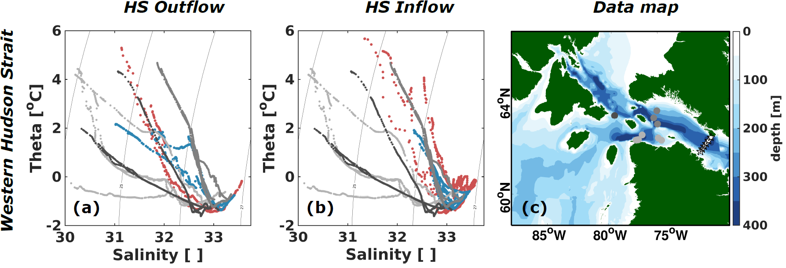
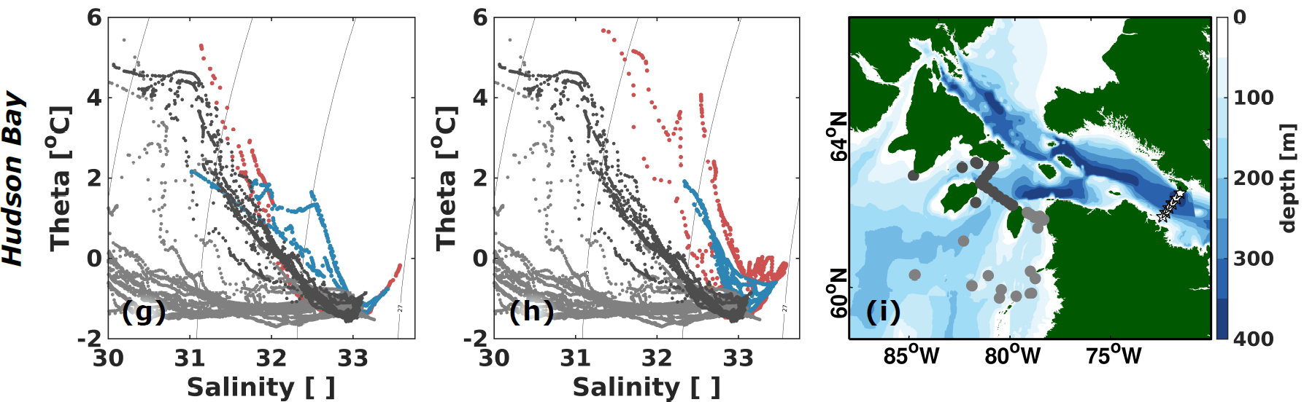
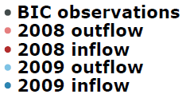
Inflow pathways: Hudson Bay
The main route of Hudson Strait waters is to northern Hudson Bay after undergoing some mixing
9

Slide 11
CONCLUSION
    Reduced variability in the inflow compared to the outflow
    Inflow waters fall within the Arctic Water category, with deep inflow waters having a small contribution from TrW or WGIW
    Hudson Strait inflow waters enter northern Hudson Bay after undergoing mixing and modification
We know that Hudson Strait receives Arctic waters from the Baffin Island Current
    Arctic outflows might contain large freshwater signals, will rerouting part of the signal in Hudson Strait reduce the impact these events have on convection regions?
ridenour@ualberta.ca
10
Notes:
Presented the first year-round data of Hudson Strait inflow

