Slide 1
Aim 1 Results

Slide 2
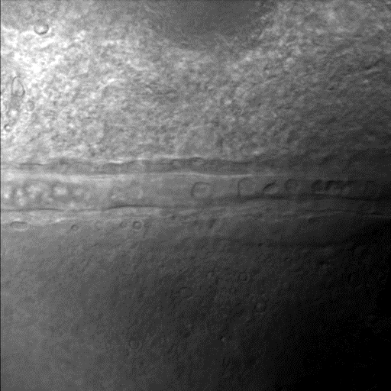
The vasodilation

Slide 3
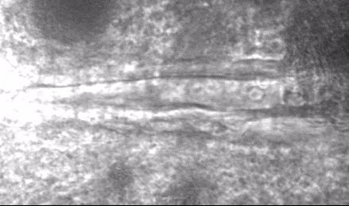
The Vasoconstriction

Slide 4
Aim 2 Results

Slide 5
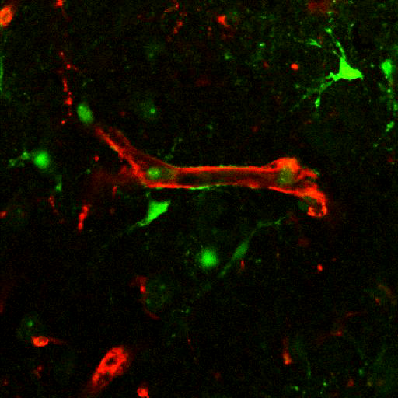
Vasodilation and decreasing of Ca2+ intensity

Slide 6
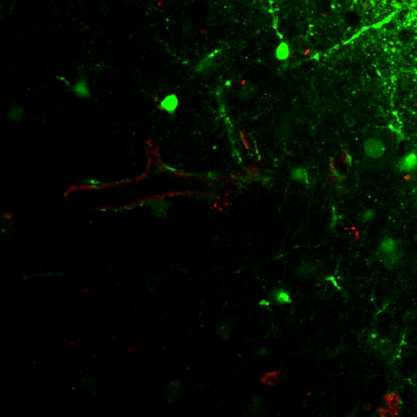
Vasoconstriction and increasing of Ca2+ intensity

